Slide 1
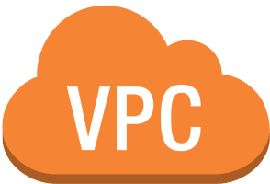
VPC — Virtual Private Networks

Slide 2
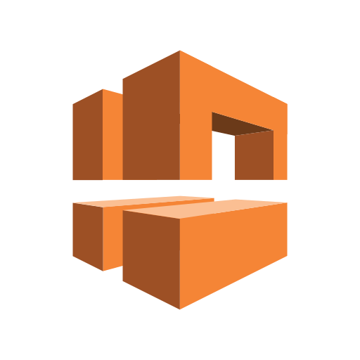
What is VPC…?
An Amazon Virtual Private Cloud (VPC) is a logically isolated, private section of the AWS cloud where you can launch and manage AWS resources within a defined virtual network. A VPC enables you to customize your networking environment, including IP address ranges, subnets, route tables, network gateways

Slide 3
Public vs. Private IP (IPv4)
• The Internet Assigned Numbers Authority (IANA) established certain
blocks of IPv4 addresses for the use of private (LAN) and public
(Internet) addresses
• Private IP can only allow certain values:
• IO.O.O.O - 10.255.255.255 (10.0.0.0/8) in big networks
• 172.160.0 - 172.31.255.255 (172.160.0/12) AWS default VPC in that range
• 192.1680.0 - 192.1 68255.255 (192.1680.0/16) e.g., home networks
• All the rest of the IP addresses on the Internet are Public

Slide 4
Default VPC on AWS
• All new AWS accounts have a default VPC
• New EC2 instances are launched into the default VPC if no subnet is specified
• Default VPC has Internet connectivity and all EC2 instances inside it have public IPv4 addresses
• We also get a public and a private IPv4 DNS names

Slide 5
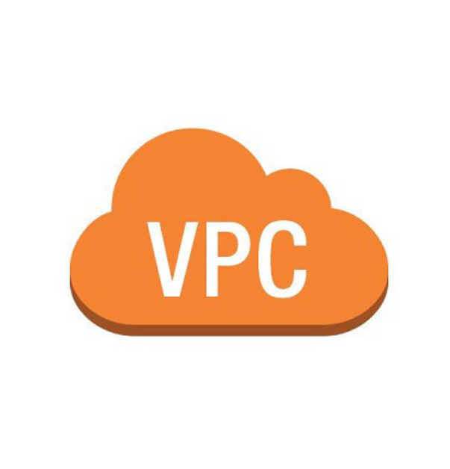
VPC in AWS -IPv4
• VPC = Virtual Private Cloud
• You can have multiple VPCs in an AWS region (max. 5 per region — soft limit)
• Max. CIDR per VPC is 5, for each CIDR:
• Min. size is /28 (16 IP addresses)
• Max. size is / 16 (65536 IP addresses)
• Because VPC is private, only the Private IPv4 ranges are allowed:
• 10.0.0.0 - 10.255.255.255 (l O.O.O.O/8)
• 172.16.0.0- 172.31.255.255 (172.160.0/12)
• 192.1680.0 - 192.1 68255.255 (192.168.00/16)
soft limit)
• Your VPC CIDR should NOT overlap with your other networks (e.g., corporate)

Slide 6
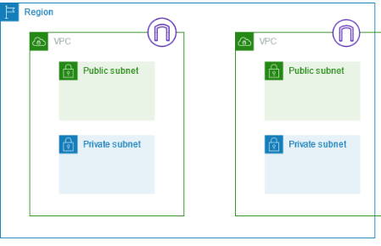
Subnets
Subnets are subdivisions of a VPC that allow you to segment the network further. Each subnet is associated with a particular Availability Zone (AZ) in a region.
Public Subnets are exposed to the internet, typically containing resources that need internet access (like web servers).
Private Subnets are isolated from the internet, ideal for internal resources like databases.

Slide 7
VPC - Subnet (IPv4)
• AWS reserves 5 IP addresses (first 4 & last l) in each subnet
• These 5 IP addresses are not available for use and can't be assigned to an EC2 instance
• Example: if CIDR block 10.0.0.0/24, then reserved IP addresses are:
• 10.0.0.0 - Network Address
• 10.0.0. I - reserved by AWS for the VPC router
• 10.0.0.2 - reserved by AWS for mapping to Amazon-provided DNS
• 10.0.0.3 - reserved by AWS for future use
• 10.0.0.255 -Network Broadcast Address. AWS does not support broadcast in a VPC, therefore the address is reserved

Slide 8
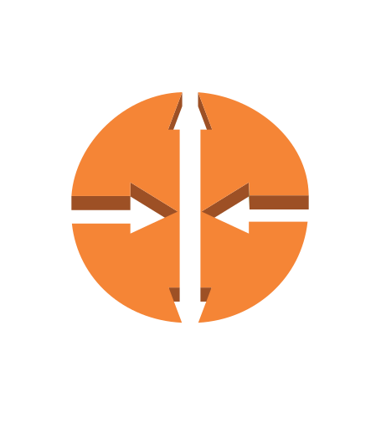
Route Tables
A route table contains a set of rules (routes) that dictate where network traffic from a subnet should go.
Each subnet is associated with a route table, which directs the traffic within the VPC and to external networks like the internet or on-premises data centers.

Slide 9
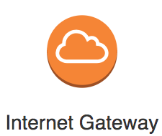
Internet Gateway (IGW):
An IGW is required to allow resources in a VPC’s public subnet to communicate with the internet.
An IGW enables outbound internet access and inbound access to resources with public IP addresses.
Must be created separately from a VPC
One VPC can only be attached to one IGW and vice versa
Internet Gateways on their own do not allow Internet access...
Route tables must also be edited!

Slide 10
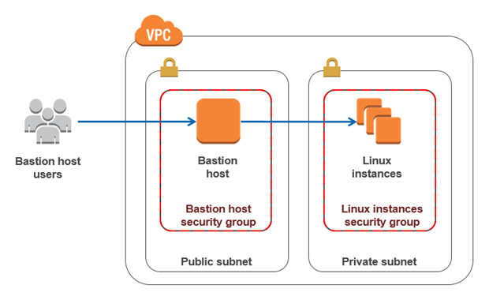
Bastion Hosts
• We can use a Bastion Host to SSH into
our private EC2 instances.
• The bastion is in the public subnet which is
then connected to all other private subnets
• Bastion Host security group must allow
inbound from the internet on port 22 from
restricted CIDR, for example the public
CIDR of your corporation.
• Security Group of the EC2 Instances must
allow the Security Group of the Bastion
Host, or the private IP of the Bastion host.

Slide 11
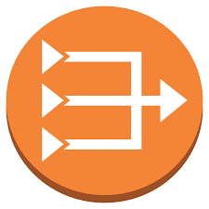
NAT Gateway
• AWS-managed NAT, higher bandwidth, high availability, no administration
• Pay per hour for usage and bandwidth
• NATGW is created in a specific Availability Zone, uses an Elastic IP
• Can't be used by EC2 instance in the same subnet (only from other
subnets)
• Requires an IGW (Private Subnet => NATGW => IGW)
• 5 Gbps of bandwidth with automatic scaling up to 45 Gbps
• No Security Groups to manage / required

Slide 12
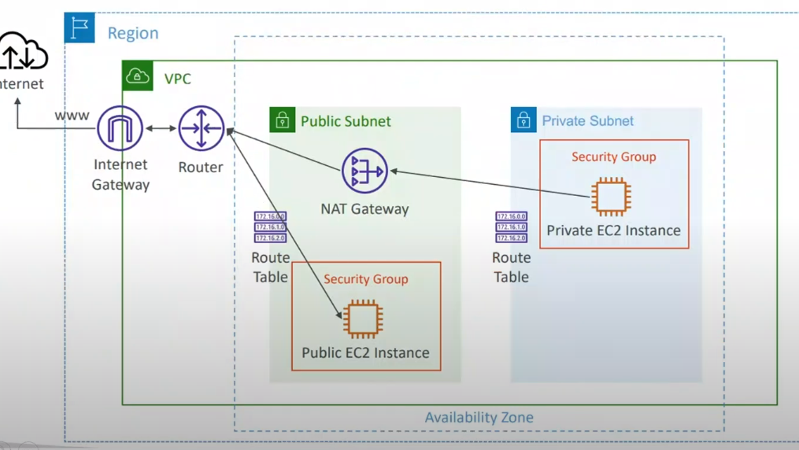

Slide 13
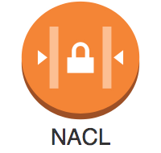
Network Access Control List (NACL)
• NACL are like a firewall which control traffic from and to subnets
• One NACL per subnet, new subnets are assigned the Default NACL
• You define NACL Rules:
• Rules have a number (l -32766), higher precedence with a lower number
• First rule match will drive the decision
• Example: if you define #100 ALLOW 10.0.0.0/32 and #200 DENY 10.0.0.10/32, the IP address will be allowed because 100 has a higher precedence over 200
• The last rule is an asterisk ( * ) and denies a request in case of no rule match
• AWS recommends adding rules by increment of 100
• Newly created NACLs will deny everything
• NACL are a great way of blocking a specific IP address at the subnet level

Slide 14
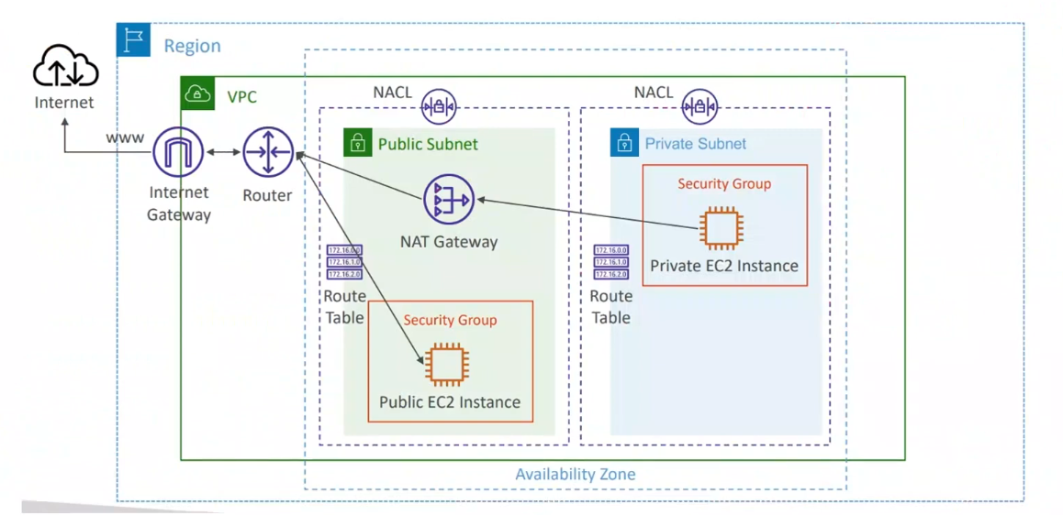

Slide 15
Use Cases for NACL
Added Layer of Security: NACLs provide an additional layer of control over traffic within a VPC, especially useful for highly sensitive applications.
Blocking IP Ranges: You can use NACLs to block specific IPs or IP ranges at the subnet level.
Compliance: NACLs can help meet specific compliance requirements by segmenting and isolating sensitive parts of your infrastructure.

Slide 16
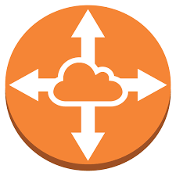
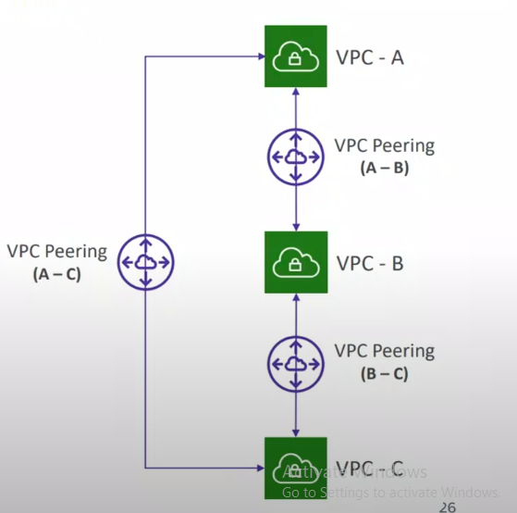
VPC peering
• Privately connect two VPCs using AWS'
network
• Make them behave as if they were in the
same network
• Must not have overlapping CIDRs
• VPC Peering connection is NOT transitive
(must be established for each VPC that
need to communicate with one another)
• You must update route tables in each VPC's
subnets to ensure EC2 instances can
communicate with each other.

Slide 17
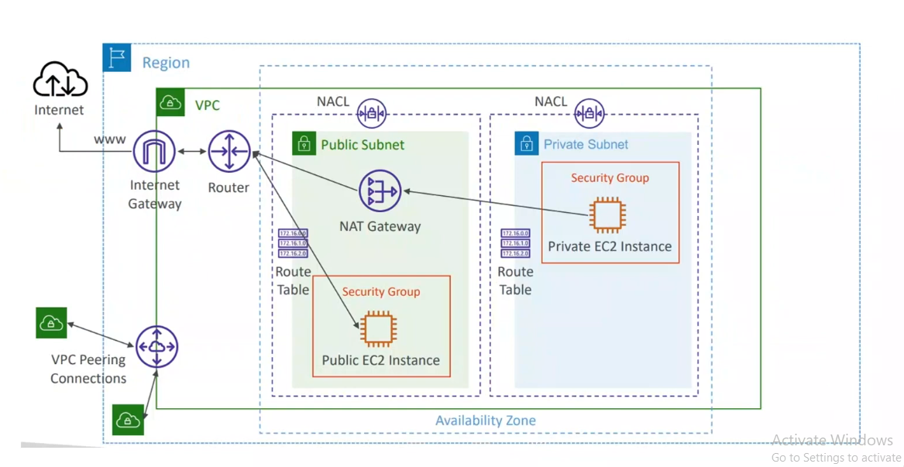

Slide 18
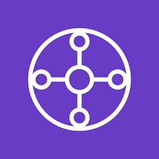
Transit Gateway
In AWS, Transit Gateway is a managed network transit hub that simplifies connecting multiple VPCs, on-premises networks, and remote networks (VPNs or Direct Connect) through a single, central gateway. It’s designed to address the scalability, complexity, and management challenges of large cloud networks, providing a hub-and-spoke model for easier routing across AWS environments.

Slide 19
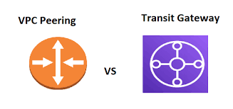

Slide 20
Feature | 🌐 VPC Peering | 🚀 AWS Transit Gateway
Architecture | 🔗 Point-to-point direct connection | 🏛️ Hub-and-spoke central gateway
Transitive Routing | ❌ Not supported | ✅ Supported
Scalability | 📈 Limited to smaller networks | 🌍 Highly scalable, supports many VPCs
Multi-Region Support | 🌎 Supports inter-region peering | 🌏 Multi-region peering via a single gateway
Setup Complexity | 🛠️ Complex with many VPCs (mesh needed) | ⚙️ Easier centralized management
Cost | 💵 Cost-effective for fewer connections | 💰 Higher cost, includes Transit Gateway fees
Best Use Case | 🔒 Direct VPC-to-VPC, small networks | 🌐 Large, complex, and multi-region networks
Performance | 🚀 Low latency, no intermediary device | ⚡ High performance with robust routing
Cross-Account Peering | 🔐 Supported (can peer across accounts) | ✅ Supported for centralized cross-account

Slide 21
